Slide 1
CHAPTER 2
ARRAYS AND STRUCTURES
All the programs in this file are selected from
Ellis Horowitz, Sartaj Sahni, and Susan Anderson-Freed
“Fundamentals of Data Structures in C”,
CHAPTER 2

Slide 2

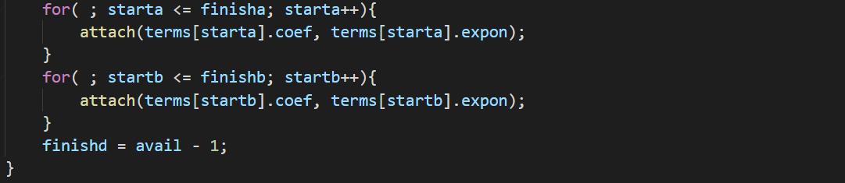
Polynomial Addition - data structure 2
目的: 將方程式A(X)和方程式B(X)相加
第一個for loop
如果方程式B已經結束時，將方程式A剩下的項目放進D(X)
第二個for loop
如果方程式A已經結束時，將方程式B剩下的項目放進D(X)
CHAPTER 2

